Slide 1

Capstone Project
AI-BASED DOCUMENT SCANNER AND OCR WEB APPLICATION
DSA-0202
Computer Vision
Course Faculty: Dr.M. Mayuranathan
Presented By:
L.Ashraf Ali(192524192)
P.Divakaran(192424260)
Kishore S.P(192511081)
S.Mithun Senthil(192324056)
J.Madhan Kumar(192524390)

Slide 2
Introduction
Paper documents are widely used in colleges, offices, libraries, and businesses.
Manual conversion of paper records into digital text is time-consuming.
Traditional scanning mainly creates image files without editable text.
OCR enables computers to recognize text contained in document images.
An AI-assisted web scanner provides faster and convenient digitization.
2
Notes:
Image source: https://img.freepik.com

Slide 3
Objectives
Develop a web application for uploading or capturing document images.
Improve document quality using image preprocessing techniques.
Extract text automatically using an OCR recognition engine.
Provide editable, searchable, and copyable extracted text.
Allow users to save and download digitized document content.
Notes:
Image source: https://img.freepik.com

Slide 4
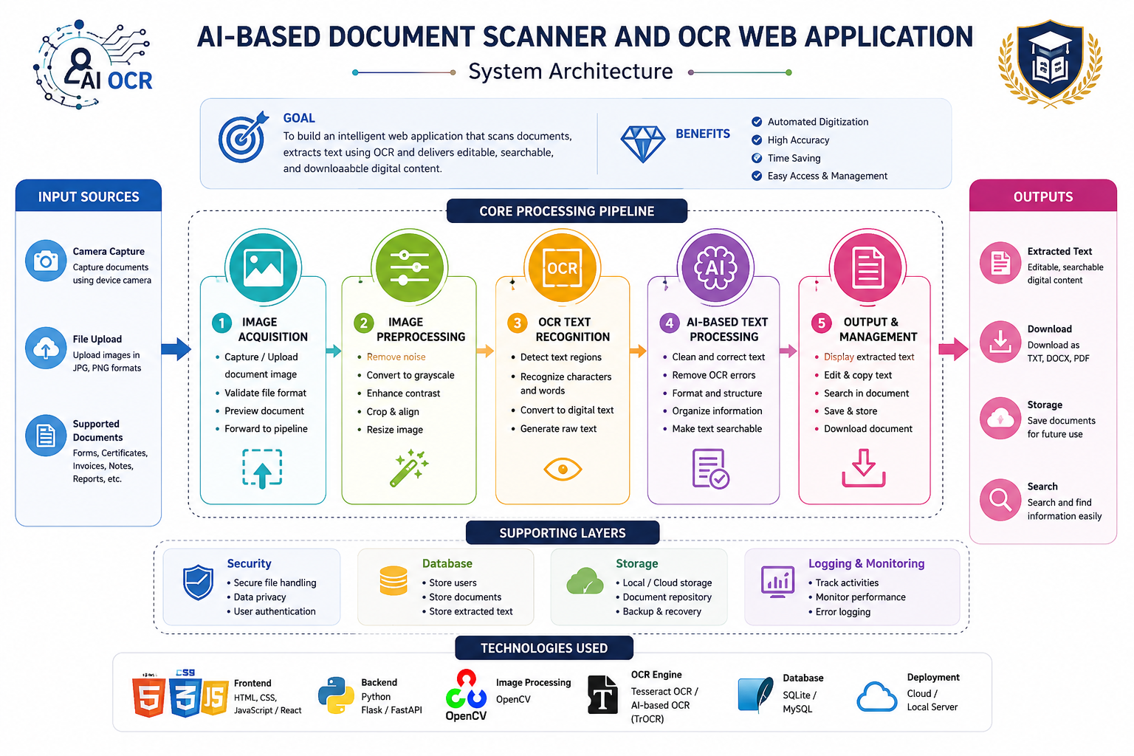
8

Slide 5
Error
Module 1: Image Acquisition Model
Description: Captures or uploads document images into the system.
Function:
Capture documents using a camera.
Upload JPG/PNG images.
Preview the selected document.
Send the image to preprocessing.
Outcome: A valid document image is obtained and prepared for further processing.

Slide 6
Error
Module 2 – Image Preprocessing
Description: Improves the quality of the captured document image before OCR.
Function:
Remove noise and unwanted background.
Convert image to grayscale.
Adjust brightness and contrast.
Crop and resize the document.
Align the document properly.
Outcome: A clear and enhanced document image suitable for accurate OCR.

Slide 7
Error
Module 3 – OCR Text Recognition
Description: Extracts text from the preprocessed document image.
Function:
Detect characters and words.
Recognize printed text.
Convert image content into machine-readable text.
Identify text regions and arrangement.
Generate initial extracted text.
Outcome: The document image is converted into digital text.

Slide 8
Error
Module 4 – AI-Based Text Processing
Description: Cleans and improves the text generated by OCR.
Function:
Correct common OCR errors.
Clean unnecessary characters.
Format the extracted text.
Organize information into meaningful sections.
Improve readability and consistency.
Outcome: Clean, structured, editable, and searchable digital text.

Slide 9
Error
Module 5 – Output & Document Management
Description: Manages the final processed document and extracted text.
Function:
Display extracted text.
Allow users to edit and copy text.
Search within extracted content.
Save processed documents.
Download the final digital document.
Outcome: A usable digital document that can be edited, searched, saved, and downloaded.

Slide 10
OCR Text Extraction Algorithm
Purpose: Extract digital text from the processed document.
Steps:
Take the preprocessed image.
Detect text regions.
Recognize characters and words.
Convert recognized characters into digital text.
Arrange and format the extracted text.
Display the final text to the user.
Input: Enhanced Document Image Output: Digital Text
Flow: Image → Text Detection → Character Recognition → Text Extraction → Digital Text

Slide 11
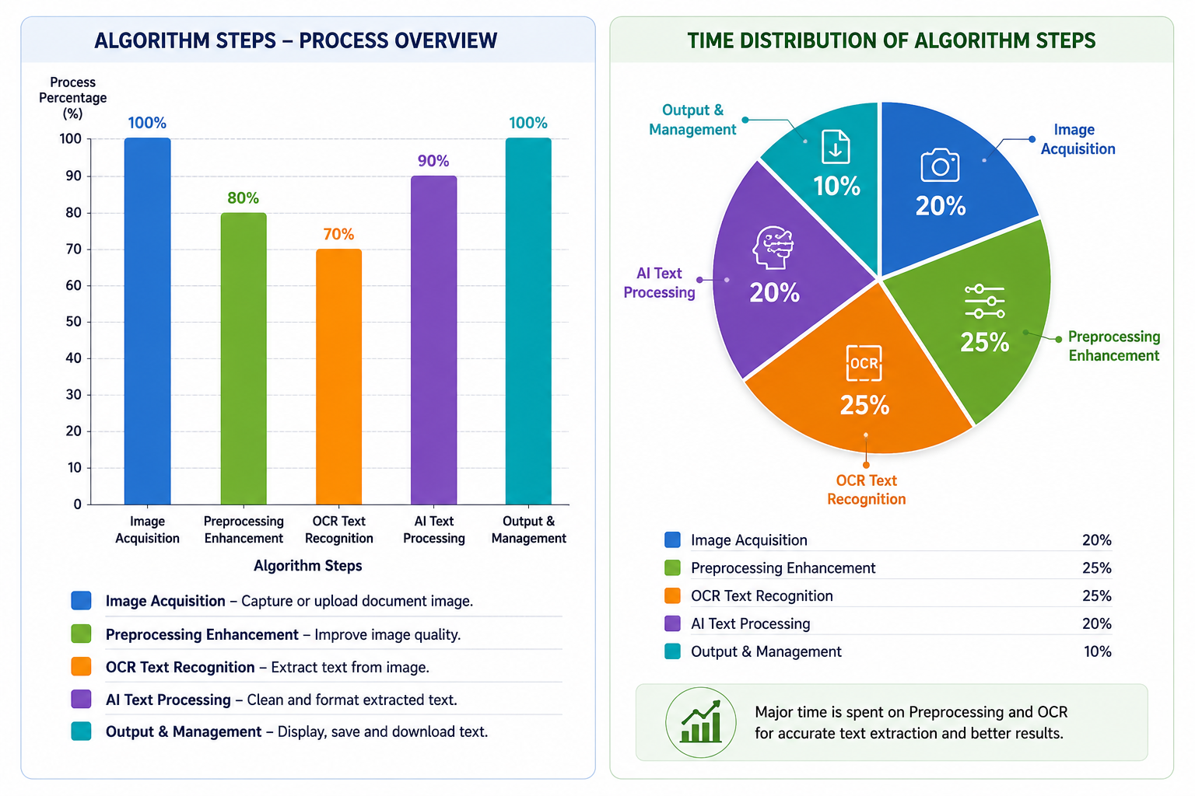


OCR Text Extraction Algorithm
Purpose: Extract digital text from the processed document.
Steps:
Take the preprocessed image.
Detect text regions.
Recognize characters and words.
Convert recognized characters into digital text.
Arrange and format the extracted text.
Display the final text to the user.
Input: Enhanced Document Image Output: Digital Text
Flow: Image → Text Detection → Character Recognition → Text Extraction → Digital Text

Slide 12
Conclusion
The system converts paper documents into digital text efficiently.
Image preprocessing improves document quality before OCR.
OCR extracts text automatically from document images.
AI-based text processing improves readability and structure.
Users can edit, search, save, and download extracted content.
The modular design makes the system easy to maintain and enhance.
Future Scope
Support multilingual text recognition.
Add handwritten text recognition.
Integrate cloud storage for document management.
Develop mobile application support.
Notes:
Image source: https://img.freepik.com

Slide 13
Results
Complete workflow connects image input, preprocessing, OCR, and text output.
Preprocessing improves document image quality.
OCR converts processed images into editable digital text.
Users can review, edit, search, copy, save, and download content.
Prototype demonstrates automated document digitization.

Slide 14
Thank You

